Slide 1
Intelligent Compaction
By: Adam Ross
KYTC Div. of Construction

Slide 2
What is Intelligent Compaction??
What is IC?
How Intelligent is smashing things together?
Why we going to use IC?
What are you going to have to do?

Slide 3
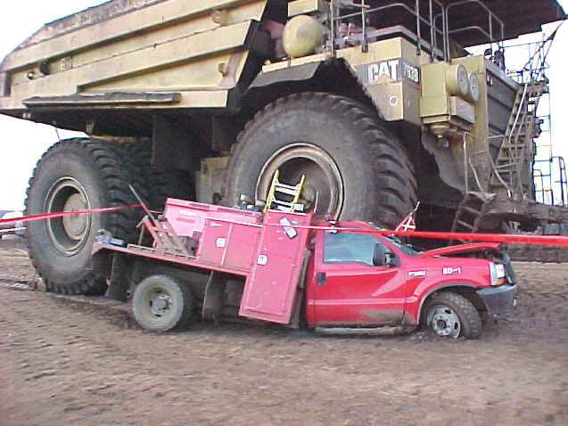
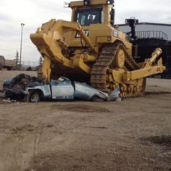
Proper compaction

Slide 4
The “Smart” Roller
Positioning System
GPS
Laser
Cell
Temperature Gauges (asphalt)
Accelerometer
Onboard Reporting System with display screen

Slide 5
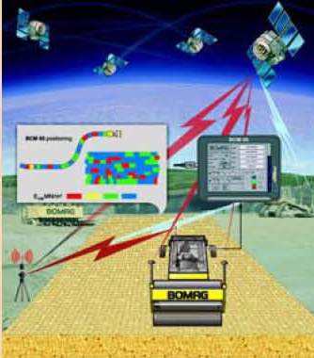

Slide 6
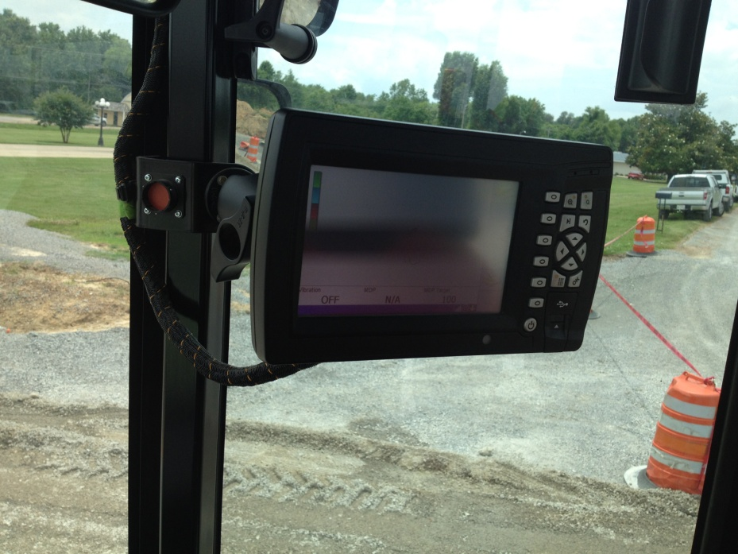

Slide 7
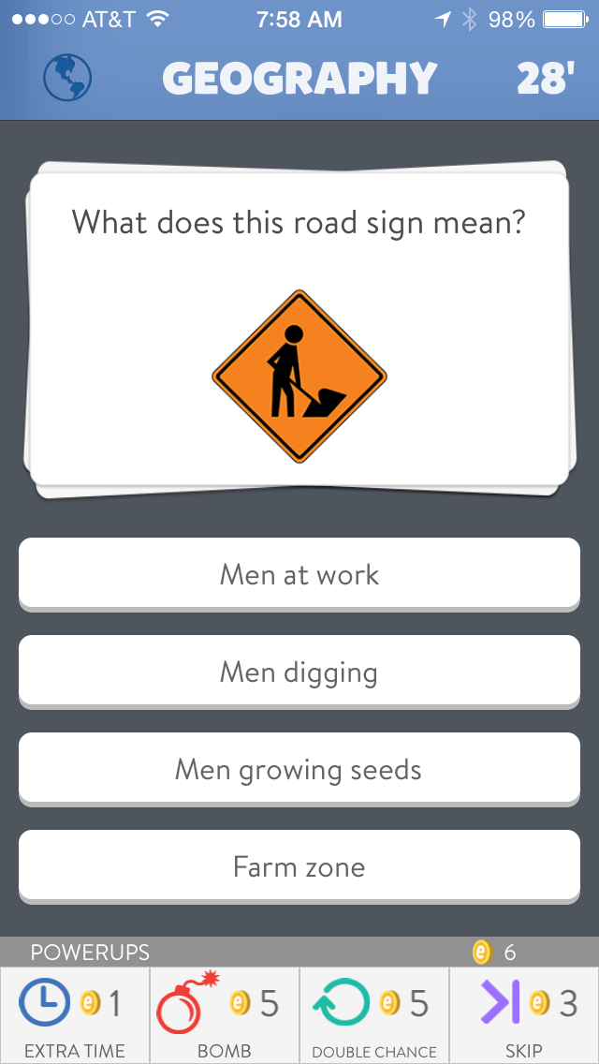

Slide 8
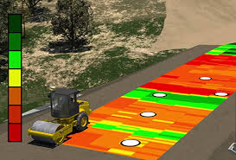

Slide 9
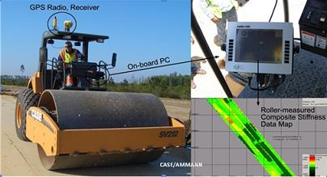

Slide 10
What it tells us
Where the roller went
What it did to the Soil, DGA, or Asphalt
Temperature of the Asphalt
Stiffness of the material

Slide 11
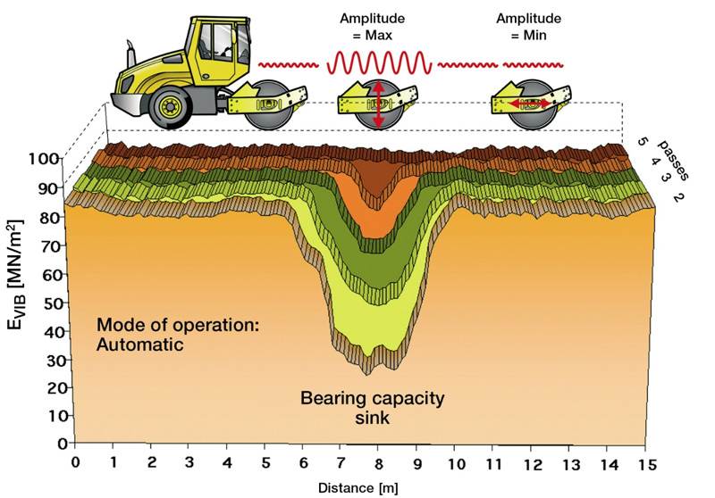

Slide 12
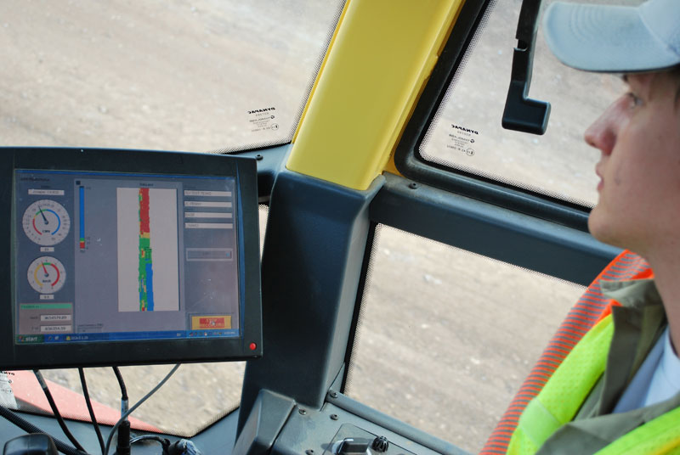

Slide 13
Why use this stuff??
Test more area
Limit amount of extra rolling
Improved Density
Increased Productivity
Reduction of Highway Repair Costs
Continuous Record of Material Stiffness Values
Identification of Non-Compacted Areas
Improved Depth of Compaction

Slide 14
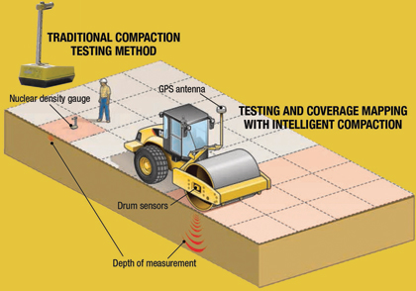

Slide 15
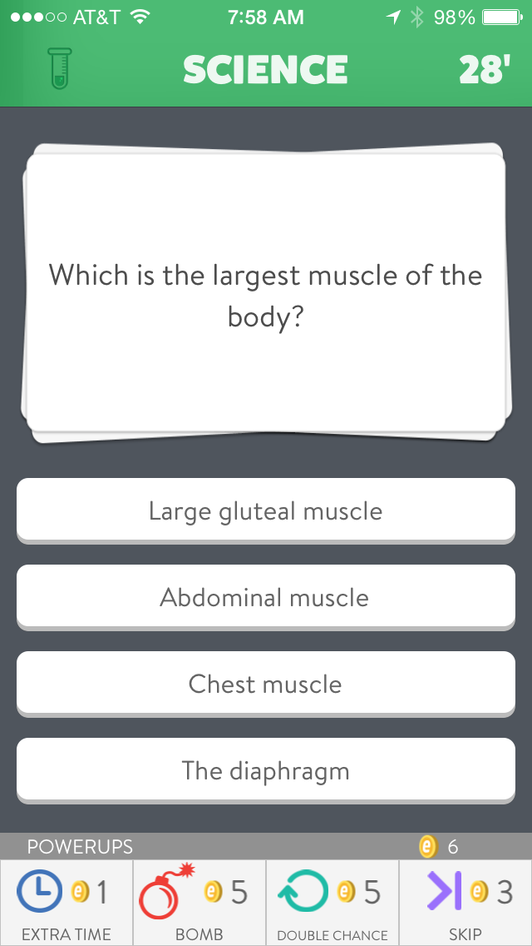

Slide 16
KYTC and IC
Special Notes
5 projects in 2015
2 Grade and Drain and Aggregate Base
2 Asphalt only
1 Soil, Ag. Base, and Asphalt
Specifications still govern acceptance

Slide 17
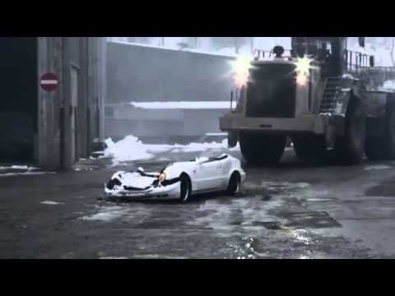
Inspection
Test strip required to set pass count and “target” stiffness
Get the data and review it (VEDA)
Have your density tests surveyed to correlate to the IC value

Slide 18
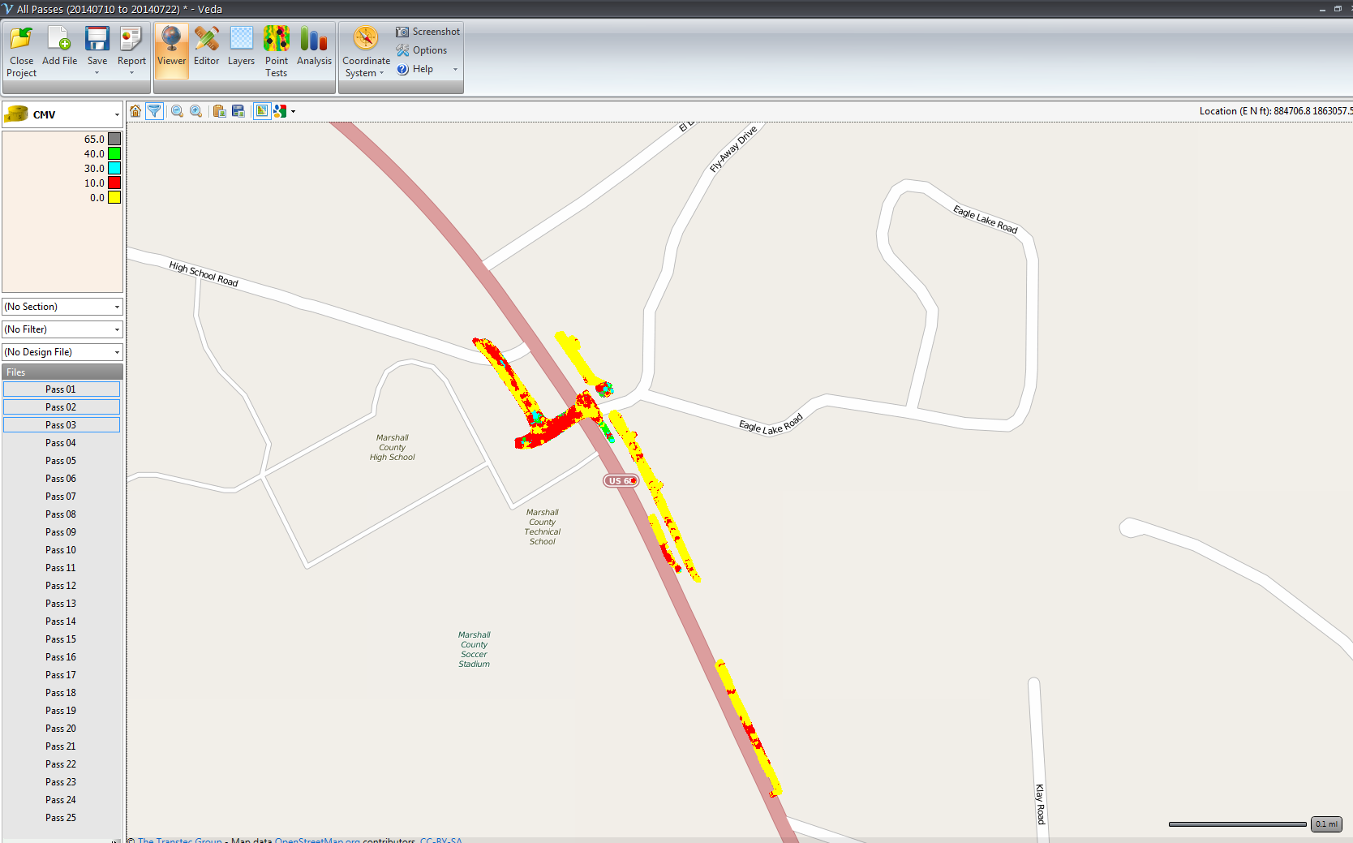

Slide 19
Lexington Workshops
April 14 at District Office
April 15 Equipment Demonstration Section office
http://www.intelligentcompaction.com/learn/workshops/current/2015-icdm-workshop-ky-01/

Slide 20

Questions?

